Slide 1
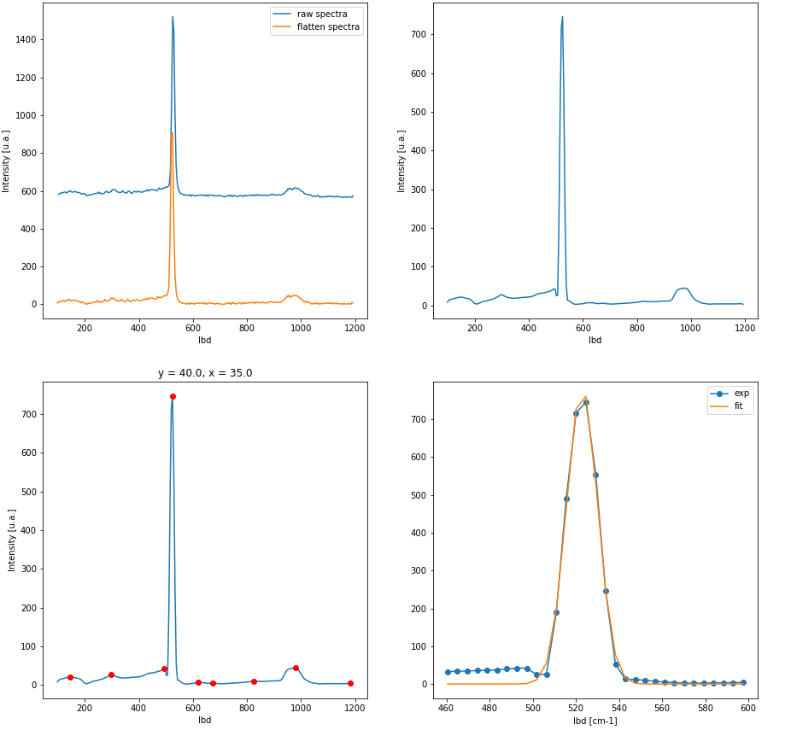
Spectra processing
Baseline removal
Spectra denoising
Peak finding
Spectra fitting

Slide 2
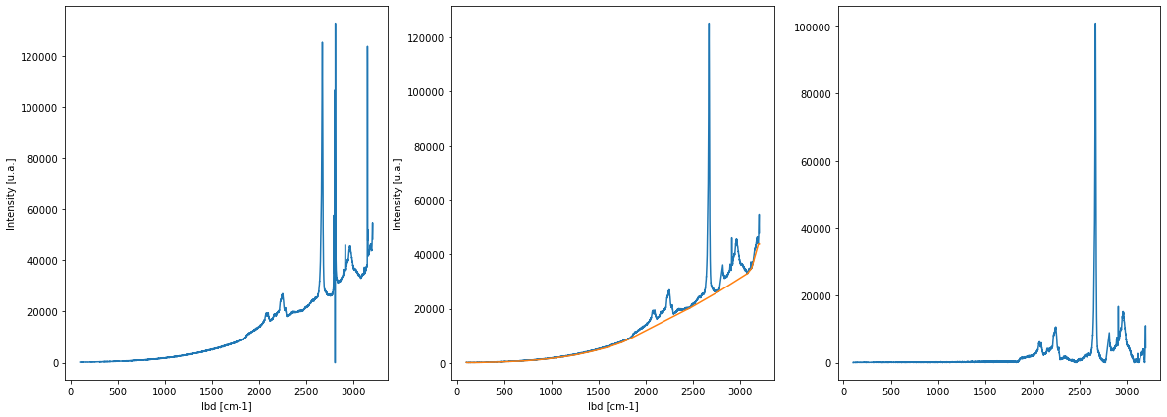
Spikes removing
Spectrum with cosmics
Cosmics removal
Flatten spectra

Slide 3
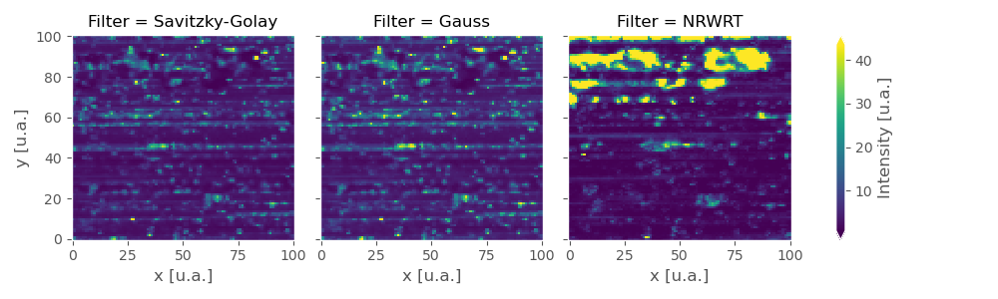
Noise (std) evaluation

Slide 4
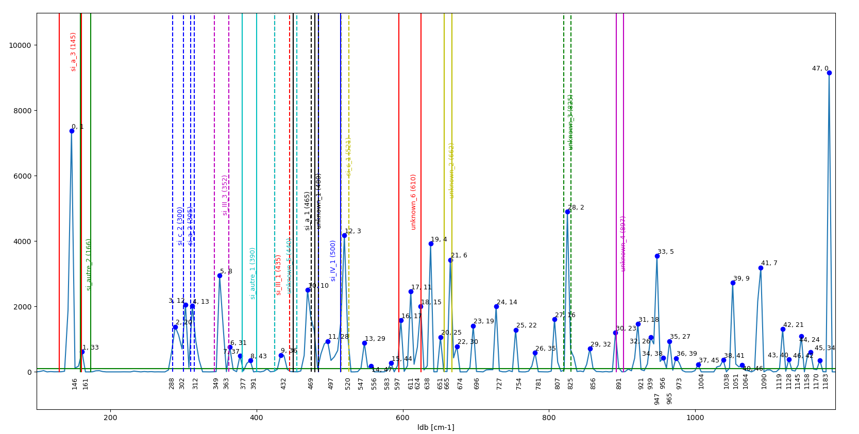
Peak occurrence statistic

Slide 5
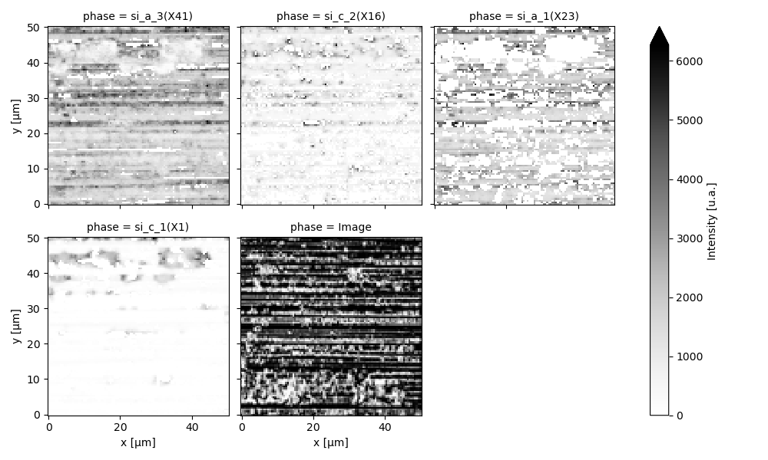
Phase imaging

Slide 6
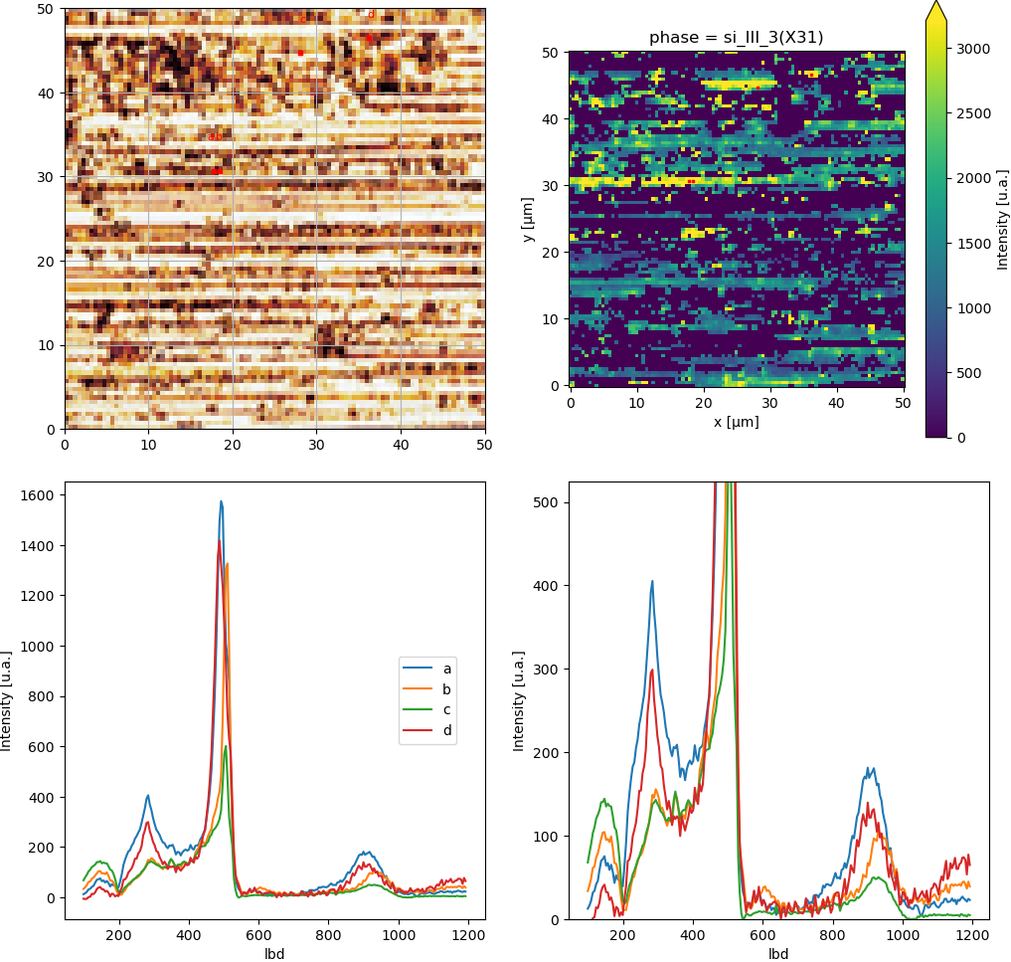
Phase imaging

Slide 7
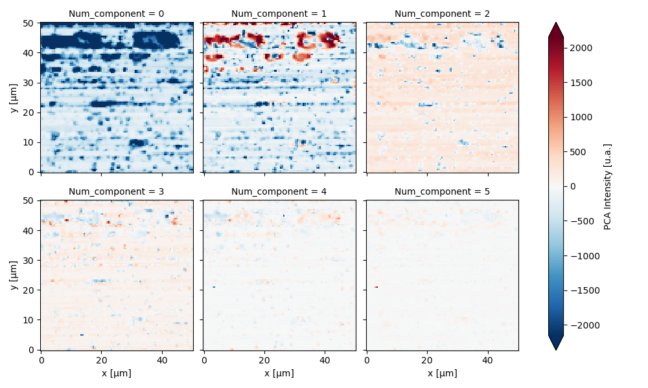
Raman PCA

Slide 8
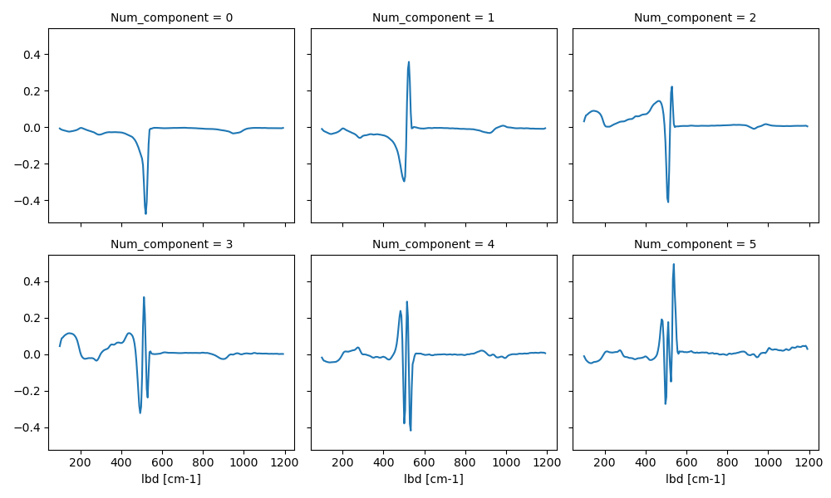
Raman PCA

Slide 9
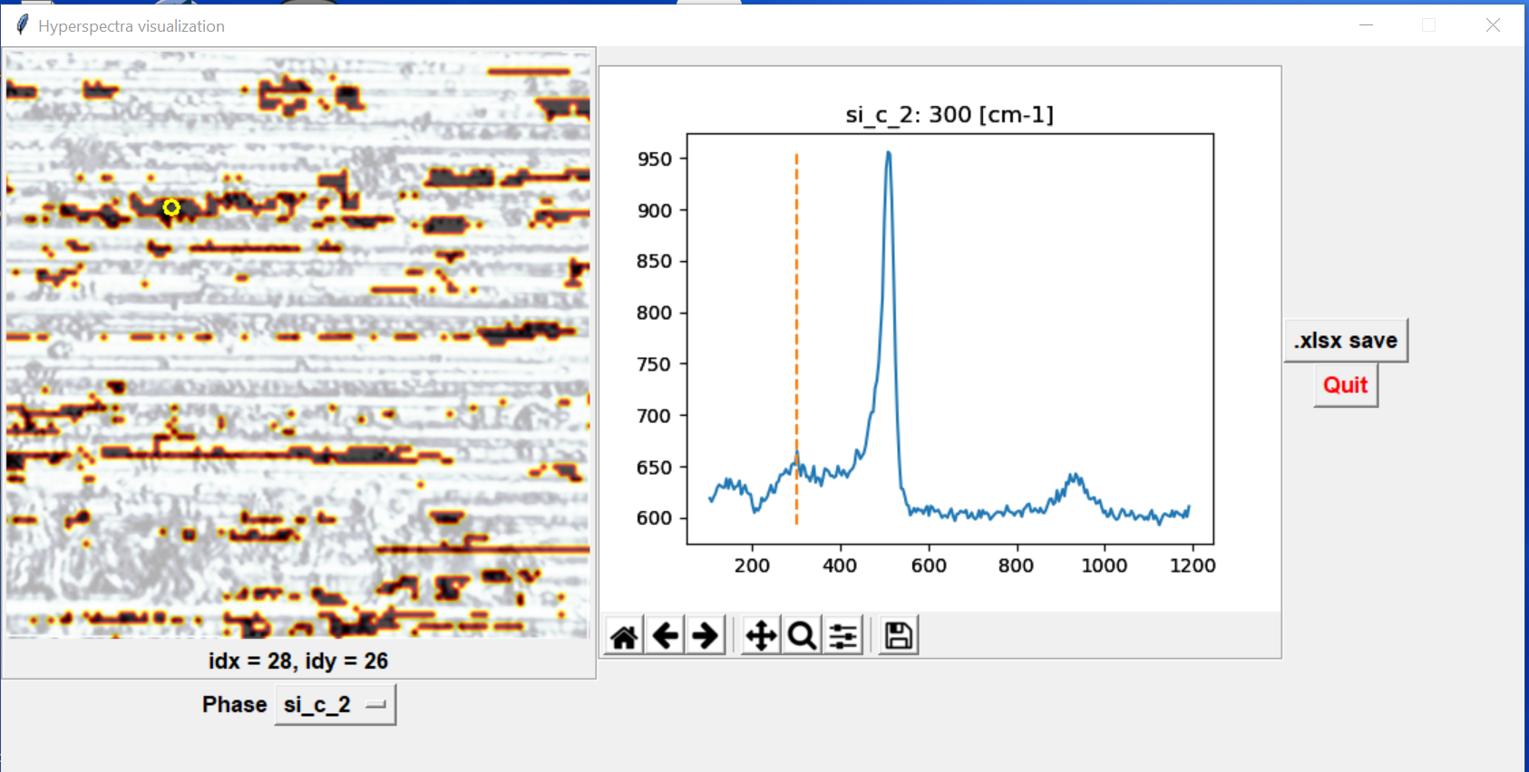
Phase visualization gui

Slide 10
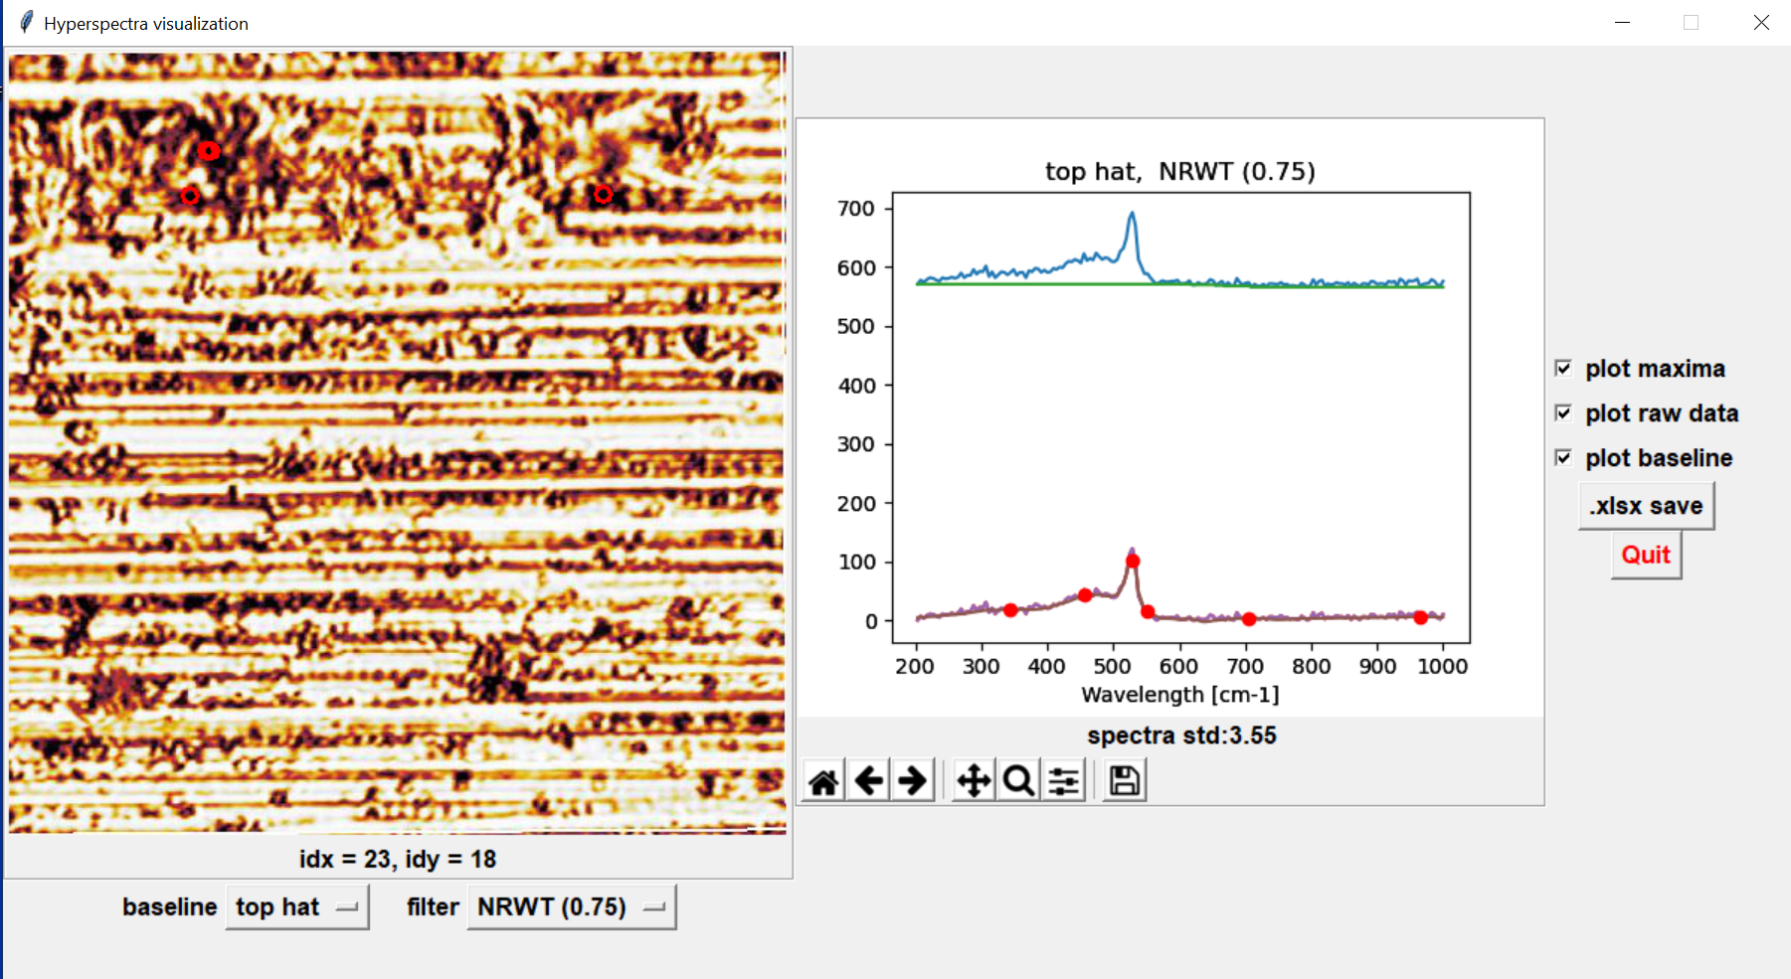
Sprectra visualisation gui

